Slide 1
Logistic Regression!!! Odds Logit Logistic Regression

Slide 2
Background / Theory / Strategy

Slide 3





What are Odds?
$$π=population proportion$$
$$ω=\frac{π}{1 − π}$$
$$"The Odds"$$
$$ω=\frac{π}{1 − π}=\frac{P(Y=1|X)}{1−P(Y=1|X)}$$
Let
$π$ = proportion of those who get an A after studying 10 hours for a test.
Assume $π$=.8
The Odds of getting an A among students who study 10 hours:
$ω=\frac{π}{1 − π}$ = $\frac{.80}{1 − .80}=4$
Interpretation: For every 1 student who studied 10 hours that did not receive an A, there are 4 that did receive an A.

Slide 4


Odds: You Try!
$$π=population proportion$$
$$The Odds=ω=\frac{π}{1 − π}$$
$$ω=\frac{π}{1 − π}=\frac{P(Y=1|X)}{1−P(Y=1|X)}$$
Consider this example:
$π$ = probability of your shoes lasting for year if they are Nikes.
Assume $π$ = .6
The odds of someone’s shoes lasting for a year if they are Nikes:
$ω=\frac{π}{1 − π}$ = $\frac{.6}{1 − .6}=1.5$
Interpretation: For every 1 pair of Nikes that do not last a year, there are 1.5 pairs of shoes that did last a year.

Slide 5

Odds: You Try!
$$π=population proportion$$
$$The Odds=ω=\frac{π}{1 − π}$$
$$ω=\frac{π}{1 − π}=\frac{P(Y=1|X)}{1−P(Y=1|X)}$$
Consider the examples from yesterday:
$π$ = proportion of those who got malaria using bed nets.
We found $\hat{π}= .044=4.4\%$
The Odds of and infant in Kenya getting malaria while using a bednet:
$ω=\frac{π}{1 − π}$ = $\frac{.044}{1 − .044}= .046$
Interpretation: For every 1 Kenyan infant that used a bednet that does not contract Malaria, there are .046 Kenyan infants that did.

Slide 6
Logistic Regression
Models relationship between set of
explanatory variables X_{i}
dichotomous (yes/no, smoker/nonsmoker,…)
categorical (social class, race, ... )
continuous (age, weight, gestational age, ...)
and
response variable Y
e.g. Success/Failure, Remission/No Remission Survived/Died, CHD/No CHD,
Low Birth Weight/Normal Birth Weight, etc…
Dichotomous and categorical
CONTINUOUS

Slide 7
Example: HorsePower v. Number of Cylinders

Slide 8
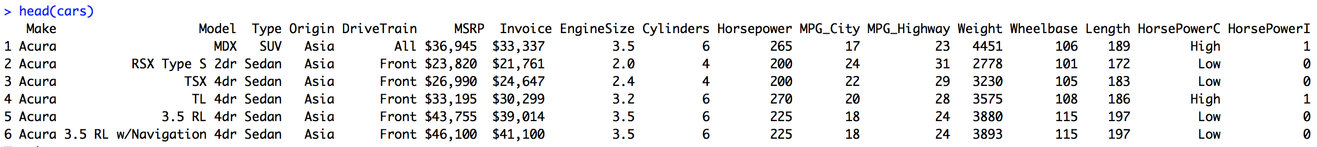
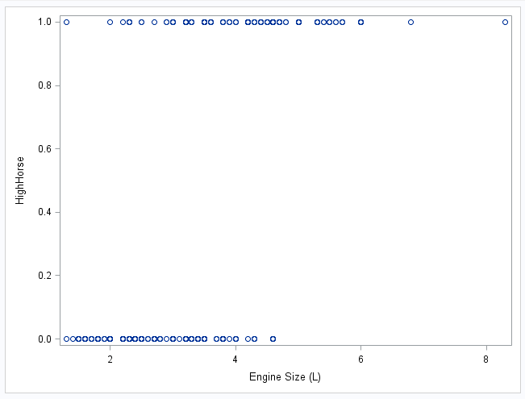

Example: Horse Power v. Engine Size
High Horse = 1 if horsepower ≥ 230
High Horse = 0 if horsepower < 230
Need a continuous variable to use multiple regression framework
We could use the proportion …
.04
.10
.12
.20
.20
.55
.78
.80

Slide 9
Example: Horse Power v. Engine Size
High Horse = 1 if horsepower ≥ 230
High Horse = 0 if horsepower < 230
Need a continuous variable to use multiple regression framework
We could use the proportion … but the proportion has range 0 to 1.
Hmmmmm……
.04
.10
.12
.20
.20
.55
.78
.80

Slide 10






Example: Horse Power v. Engine Size
THE ODDS!
Need a continuous variable to use multiple regression framework
We could use the proportion … but the proportion has range 0 to 1.
Hmmmmm……
We would like to have a response that was continuous across the real line!
$$The Odds=ω=\frac{π}{1 − π}$$
$$π=population proportion$$
$$ω=\frac{π}{1 − π}=\frac{P(Y=1|X)}{1−P(Y=1|X)}$$
$$The odds are continuous from:$$
$$0 to infinty$$
$$So…to get the whole real line …$$

Slide 11



Example: Horse Power v. Engine Size
THE LOG ODDS!
Continuous response variable from –infinity to +infinity
Often linearly related to the explanatory variable.
$$The Log Odds=log⁡(ω)=log⁡(\frac{π}{1 − π})$$
$$π=population proportion$$
$$\log\left(ω\right)=β_{0}+β_{1}X_{1}+β_{2}X_{2}…$$
$$logit(π)=β_{0}+β_{1}X_{1}+β_{2}X_{2}…$$

Slide 12
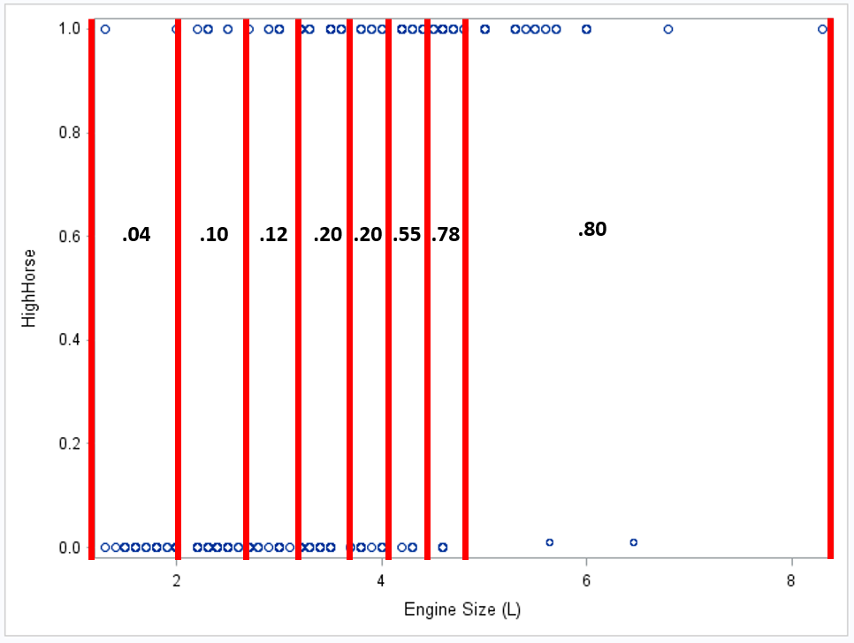
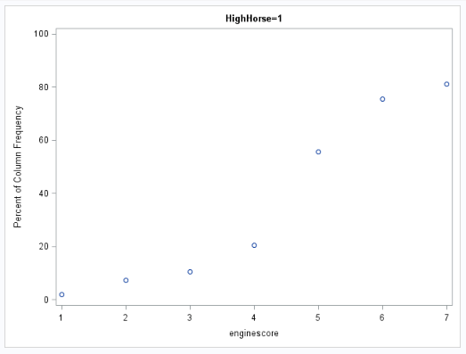
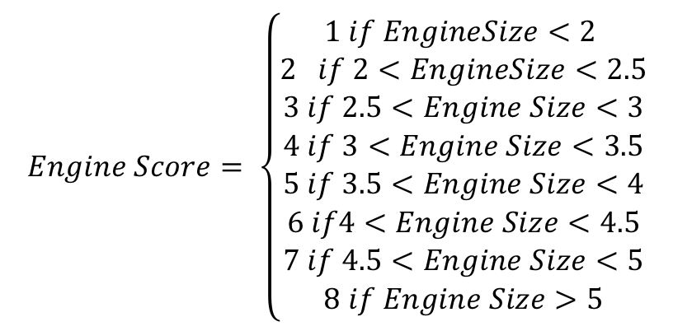
Example: Horse Power v. Engine Score
To get a proportion, we need to “bin” the observations.
$$Engine Score= \left\{\begin{aligned}1 if EngineSize<2 \\ 2 if 2<EngineSize<2.5 \\ 3 if 2.5<Engine Size<3 \\ 4 if 3<Engine Size<3.5 \\ 5 if 3.5<Engine Size<4 \\ 6 if4<Engine Size<4.5 \\ 7 if 4.5<Engine Size<5 \\ 8 if Engine Size>5\end{aligned}\right.$$
1
2
3
4
6
5
7
8
Engine Score
Visualize the trend between the proportion and the engine score!
Still a bit non-linear. LOGIT ….

Slide 13
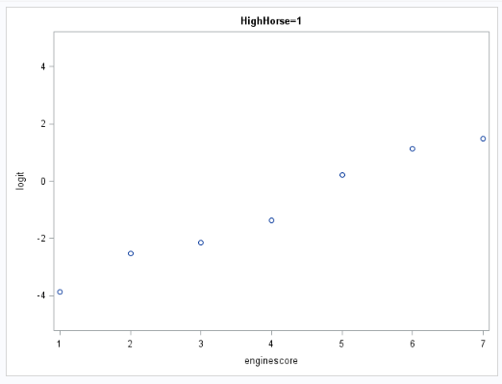
Example: Horse Power v. Engine Score
$$The Log Odds=log⁡(ω)=log\left(\frac{π}{1 − π}\right)=logit(π)$$
The logit has a much more linear relationship with engine score!

Slide 14
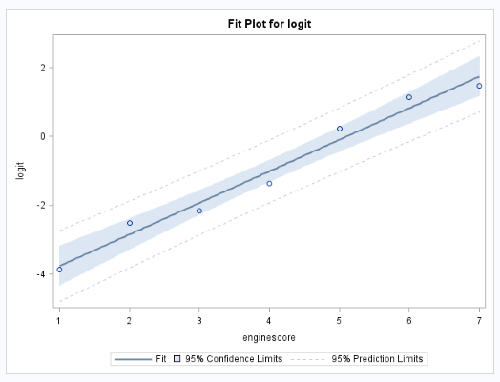

Example: Horse Power v. EngineScore

Slide 15
Logit Transformation
The logit transformation gives way to the logistic regression model
(solving for P(Y|X)):
Note: The logit transformation is also known as the logit link function.

Slide 16
What will we do in Practice?
The previous slides were aimed at showing the big picture. They were aimed at showing the strategy behind logistic regression.
The “binning” was performed so we could SEE the strategy. In practice do not need to “bin” the observations to perform logistic regression.
We can fit the logistic function
Using the raw un-binned data…

Slide 17
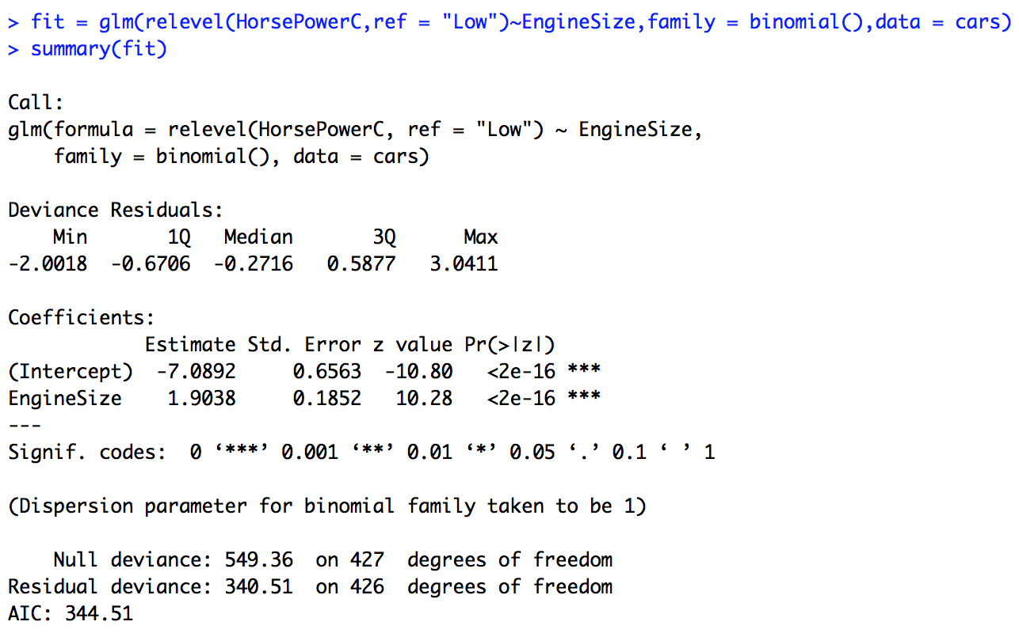


More Information by not Grouping Engine Size.
We only binned the engine sizes earlier to “see” the proportions. We do not need to do this in practice.
$$P\left(Y | X\right)= \frac{e^{β_{0}^{}+β_{1}^{}X_{1}}}{1+e^{β_{0}^{}+β_{1}^{}X_{1}}}=\frac{e^{−7.0892+1.9038∗Engine_Size}}{1+e^{−7.0892+1.90388Engine_Size}}$$
The estimated proportion of cars that have “High Horsepower” given that they have an engine size of 3.0 is: $\frac{e^{−7.0892+1.9038(3.0))}}{1+e^{−7.0892+1.9038(3.0))}}$ = .2014 = 20.14% (pvalue < .0001).

Slide 18
Let’s Try One!
Assume we want to predict the probability of being admitted to SMU given a GRE score. Say we have data from the last 10 years. And have the following results from a logistic regression of Admit ( 0 or 1) on GRE score (0 – 2400).
A) Estimate the odds of being admitted for a student who applies with a GRE of 1200.
B) Estimate the proportion of students who are admitted who apply with a GRE of 1200.
Parameter | DF | Estimate | SE | Wald | Pr>Chi Sq
Intercept | 1 | -12.034 | 1.3 | 85.7 | Pr < .0001
GRE | 1 | .01234 | .0012 | 105.7 | Pr < .0001
A) The odds of being admitted with a GRE score of 1200 are estimated to be
e^{-12.024+ .01234*1200} = 16.2 (pvalue < .0001). In other words, for students with a 1200, for every one non-admitted student there are 16.2 admitted students.
B) The proportion of students admitted who are admitted with a GRE of 1200 are estimated to be: e^{-12.034+.01234*(1200)}/(1+e^{-12.034+.01234*(1200)}) = .94 = 94%.

Slide 19
Scoring / Confusion Matrices / Classification Statistics

Slide 20
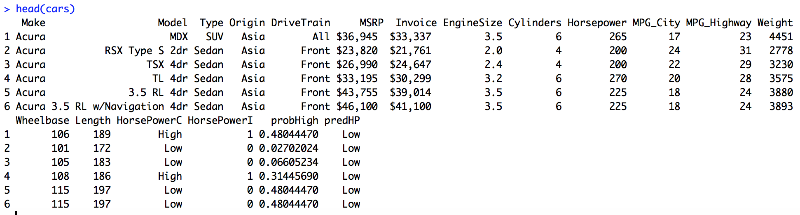
Remember the Cars data Set
4
8
16
17

Slide 21
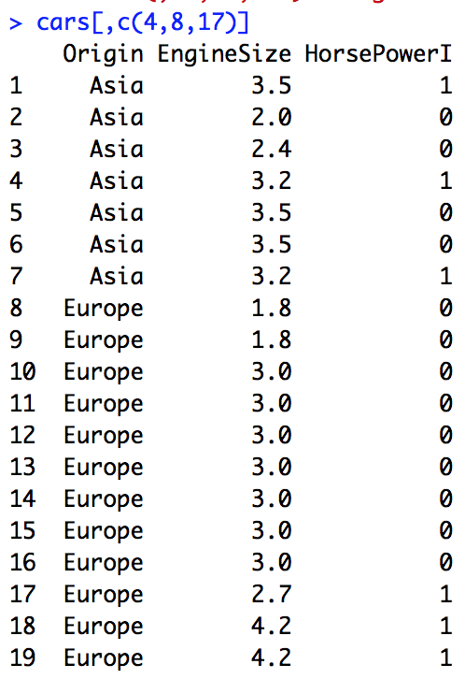
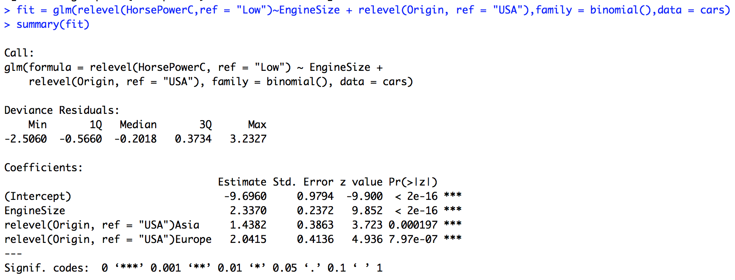
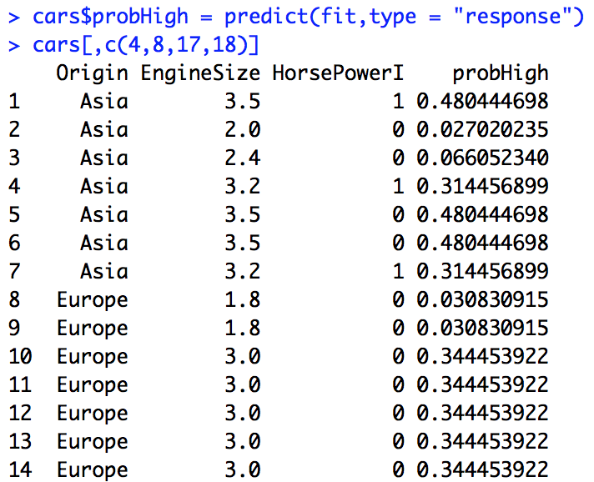
Scoring a Data Set (Making predictions)
This codes Low as a 0 and High as a 1.

Slide 22
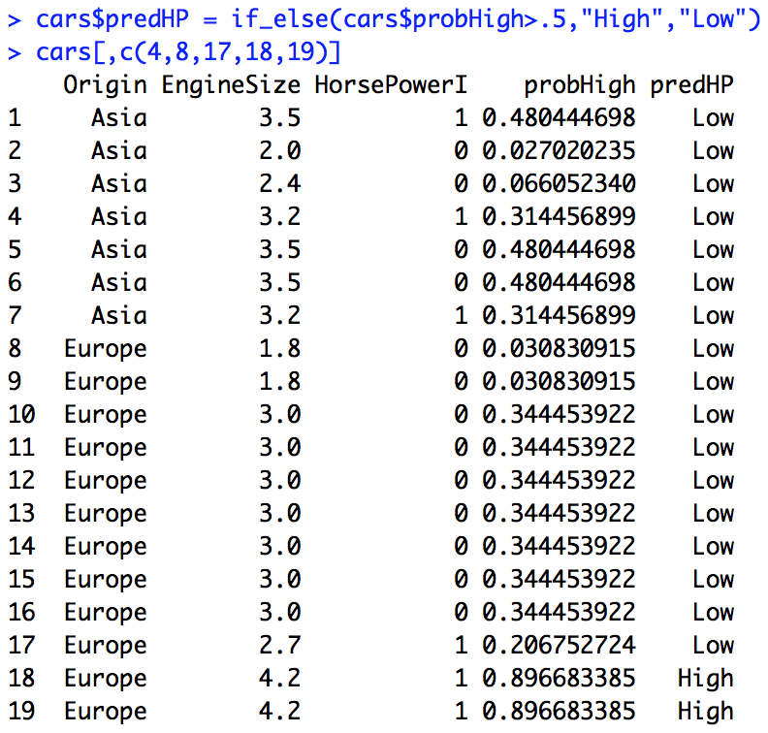
Scoring a Data Set (Making predictions)

Slide 23
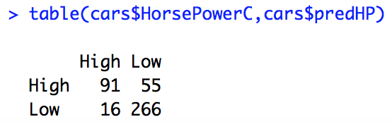
Classification / Confusion Matrix
A Confusion Matrix is a table that summarizes the classification performance of a model. One direction displays the actual value and the other direction displays the value that was assigned through the model (the classification).
Confusion Matrix for Prob Level: 0..5.
Row (Actual)
Column (Predicted)
Predicted
(Actual)
 | CLASSIFIED AS High HP | CLASSIFIED AS Low HP
High HP | 91 | 55
Low HP | 16 | 266

Slide 24
Confusion Matrix Statistics
 | CLASSIFIED AS High HP | CLASSIFIED AS Low HP
High HP | 91 | 55
Low HP | 16 | 266
(Actual)
Misclassification Rate: Number of misclassified observations / total: 71 / 428 = .1659 = 16.59%
Sensitivity: Mathematically simply the number of correctly identified successes divided by the true number of successes: 91 / 146 = .6233 = 62.33%
Specificity: Mathematically simply the number of correctly identified failures divided the true number of failures. 266 / 282 = .9433 = 94.33%
False Positives: The number of true failures identified as successes divided by the total number of classified successes: 16 / 107 = .1495 = 14.95%
False Negatives: The number of true successes identified as failures divided by the total number of classified failures: 55 / 321 = .1713 = 17.13%

Slide 25
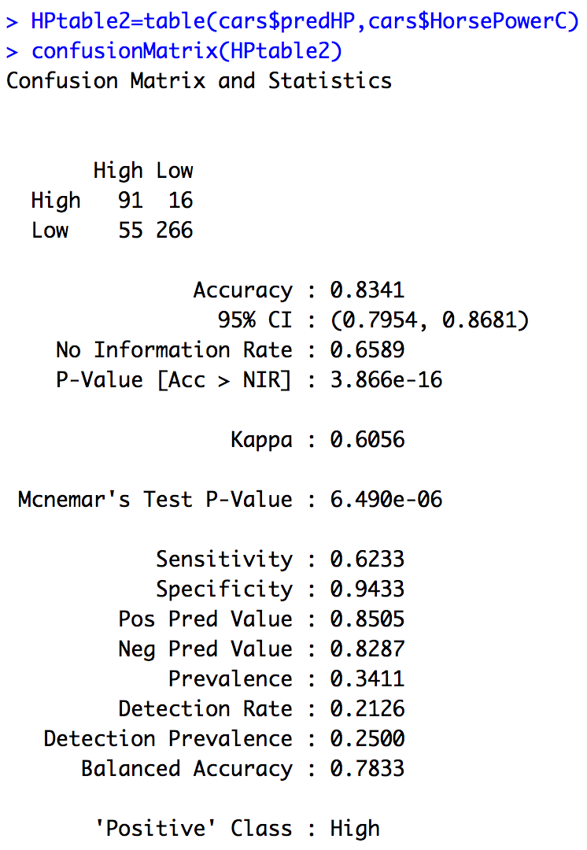
Using the caret package and confusionMatrix()
note: to use the caret package predictions have to come first and the actuals second in the table.
Misclassification Rate: Number of misclassified observations / total: 71 / 428 = .1659 = 16.59%
Sensitivity: Mathematically simply the number of correctly identified successes divided by the true number of successes: 91 / 146 = .6233 = 62.33%
Specificity: Mathematically simply the number of correctly identified failures divided the true number of failures. 16 / 282 = .0567 = 5.67%
False Positives: The number of true failures identified as successes divided by the total number of classified successes: 16 / 107 = .1495 = 14.95%
False Negatives: The number of true successes identified as failures divided by the total number of classified failures: 55 / 321 = .1713 = 17.13%

Slide 26
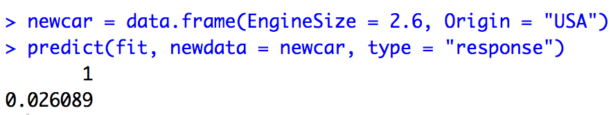
Making a Prediction
#Make a prediction of High HorsePower for a US car that has engine size = 2.6
newcar = data.frame(EngineSize = 2.6, Origin = "USA")
predict(fit, newdata = newcar, type = "response")

Slide 27
TRY One! Classification of Admittance with Respect to GRE Score and Gender.
Load the CollegeEntrance.csv file
Perform a Logistic Regression to predict the Result (Admit, Deny) using the explanatory variables GRE and Gender.
Is there sufficient evidence to suggest that the probability (or the odds) of admittance depends on Gender? Why?
Assume your client has suggested to keep Gender in the model no matter what the statistical result is. Evaluate the performance of your model using a confusion matrix and finding the accuracy, sensitivity an specificity. (Hint: You will need to filter out the row with the missing result.)
Use this model to predict the admission result (Admit or Deny) of a female who scored 1188 on the GRE (the student with the missing result in the dataset.) What were the corresponding probabilities behind the classification?
Nice work!
# Code for this problem
College = read.csv(file.choose(),header = TRUE)
str(College)
fit = glm(relevel(Result, ref = "Deny")~GRE + Gender, family = "binomial", data = College)
summary(fit)
which(is.na(College$Result))
College2 = College[-197,]
College2$probAdmit = predict(fit,type = "response")
College2$predAdmit = if_else(College2$probAdmit > .5, "Admit","Deny")
AdmitTable = table(College2$predAdmit,College2$Result)
confusionMatrix(AdmitTable)

